Slide 1
Paper Ghosts- The Space Between
3365QCA_P1 Viva Presentation
Kitten Xaos
Alanna Bingham
s5061237

Slide 2
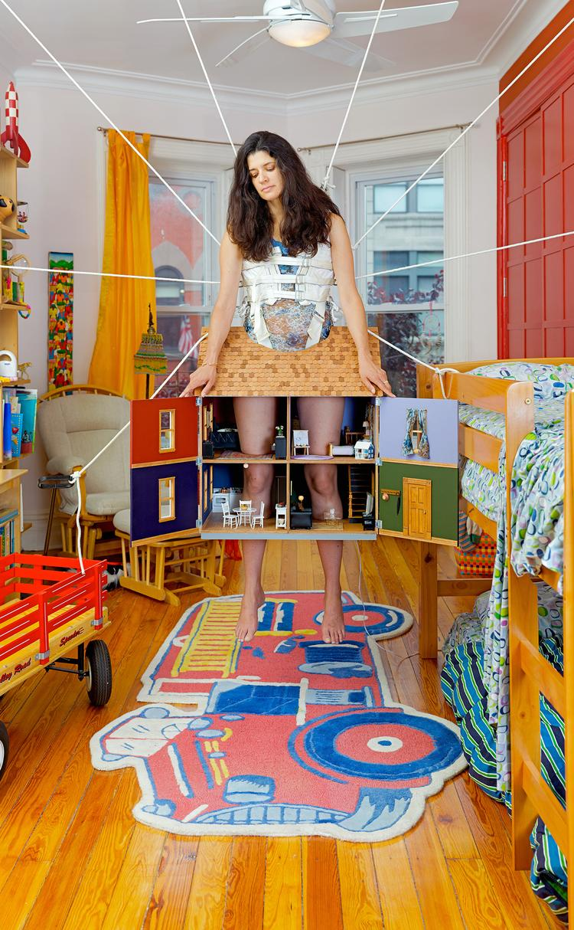
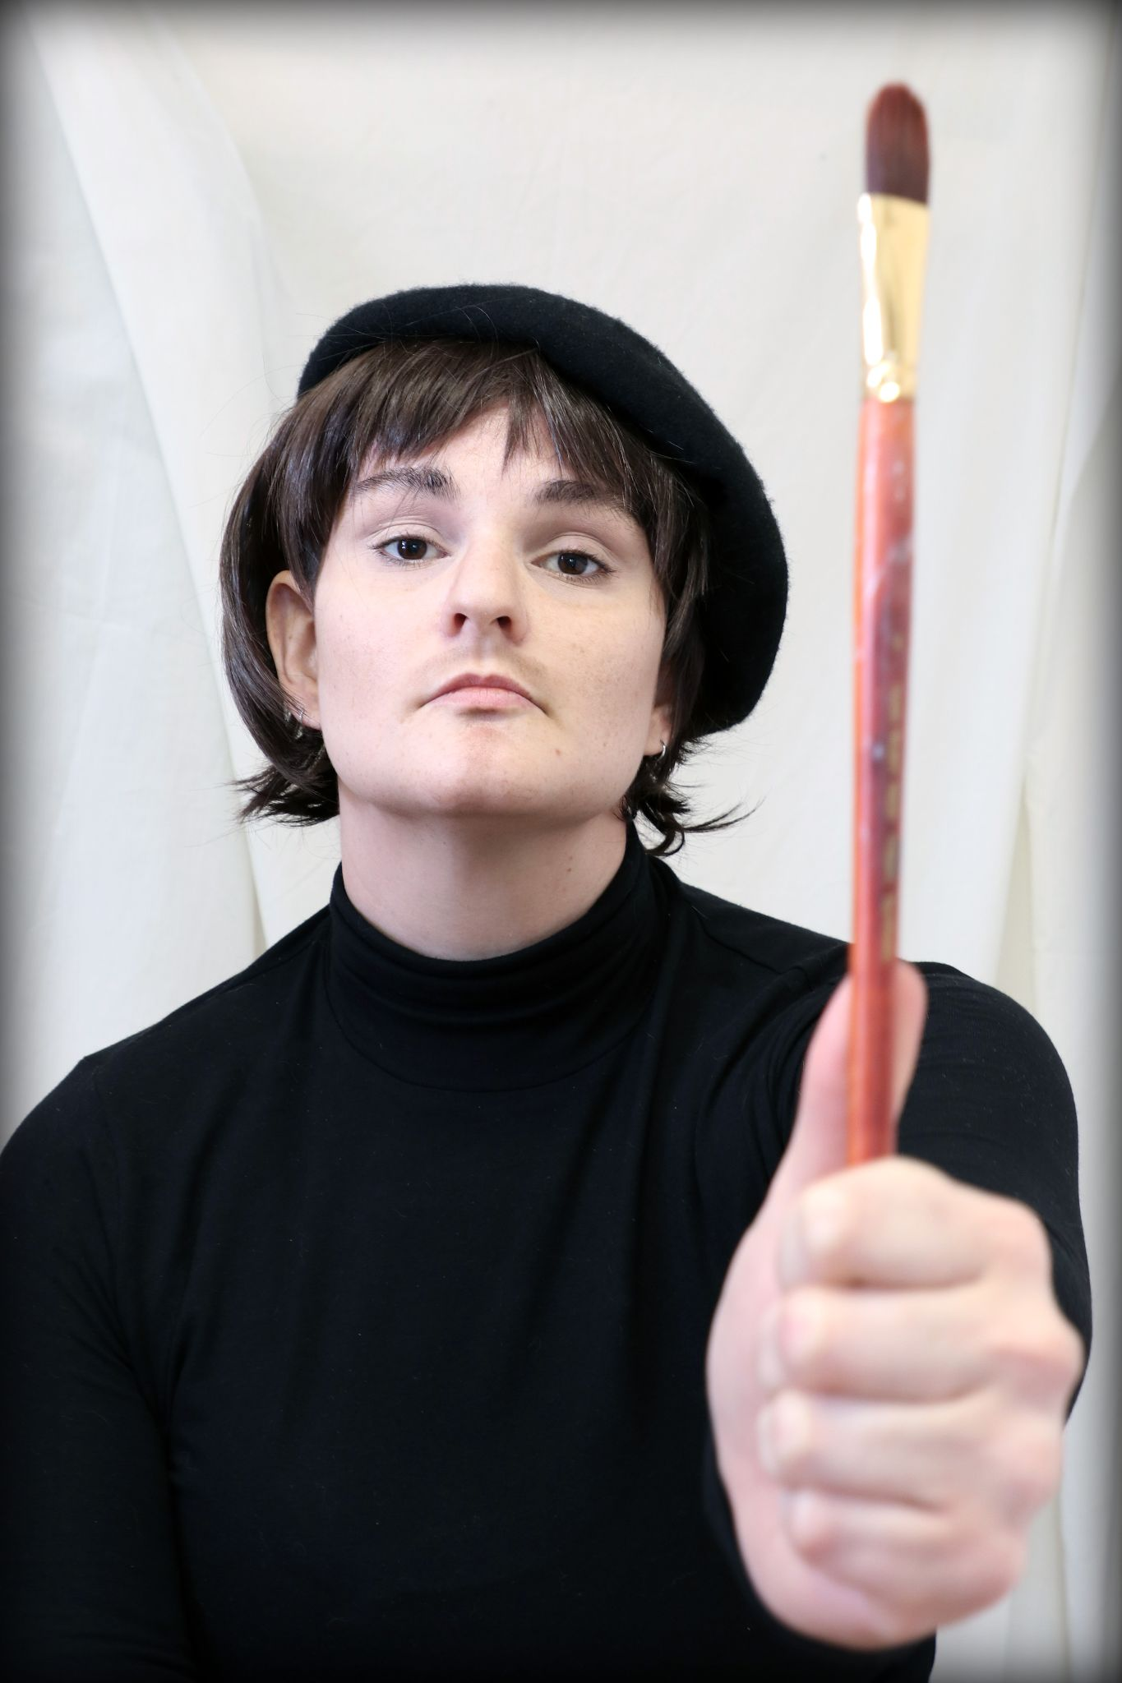
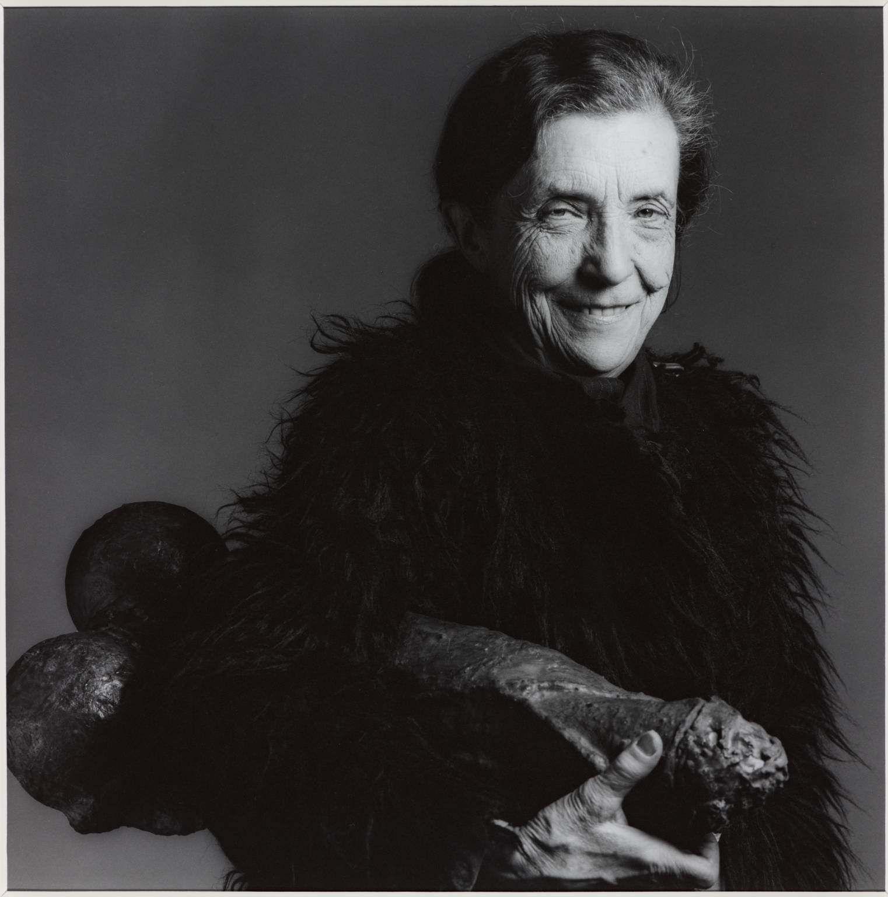
The Artist
Robert Mapplethorpe
Louise Bourgeois
1982
Janine Antoni
Inhabit
2009
Kitten Xaos
Artists in Interview- R.R Johnson
2020

Slide 3
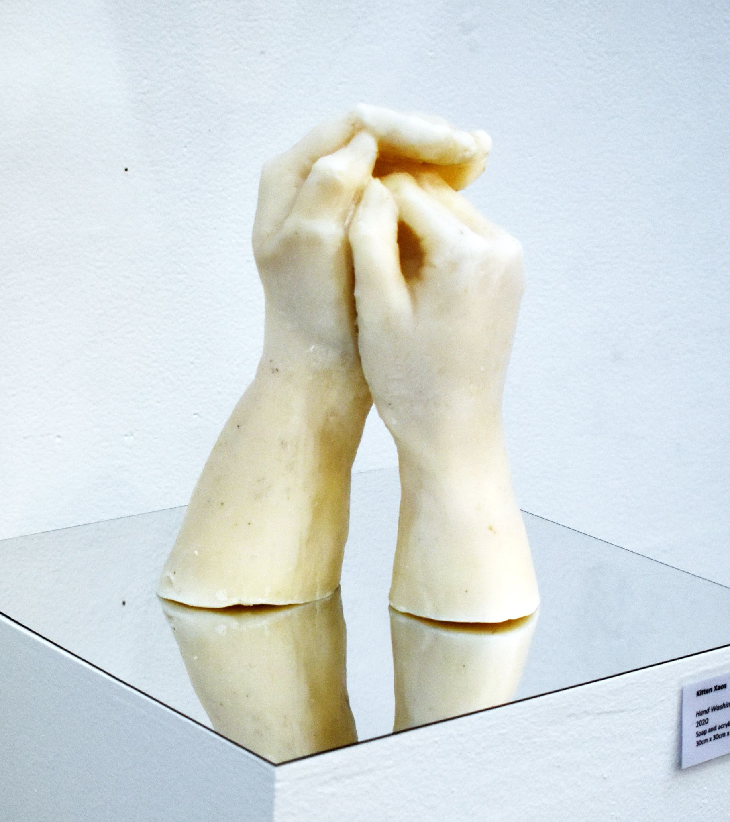
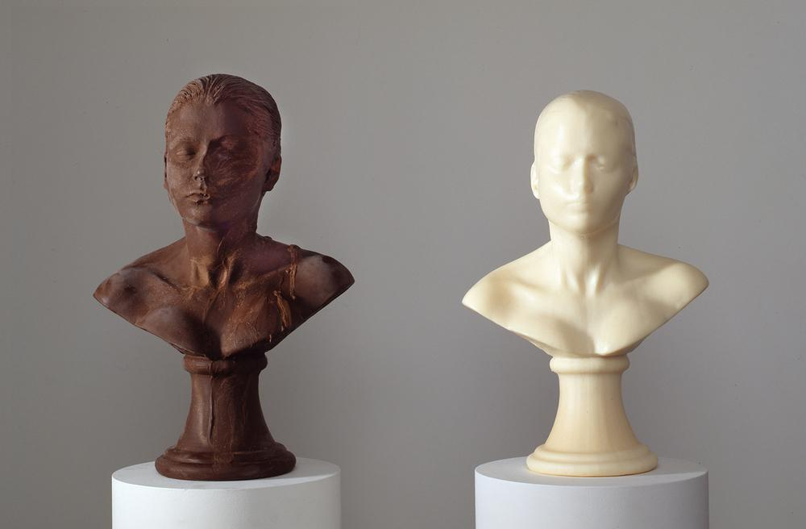
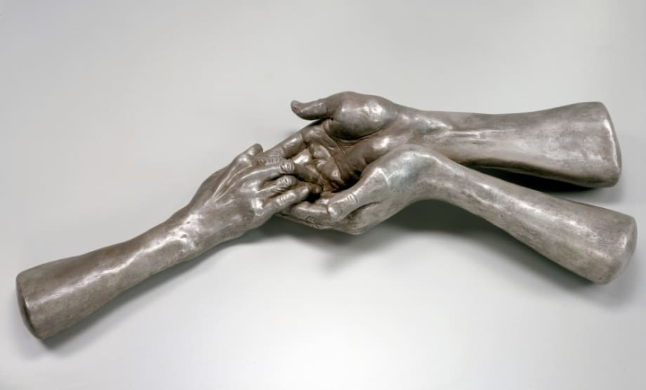
The Art
Louise Bourgeois
The Welcoming Hands
1996
Janine Antoni
Lick and Lather
1993
Kitten Xaos
Hand Washing Technique 8
2020

Slide 4
The Theory
Marcel Duchamp, The Creative Act, Lecture Lecture at the Museum of Modern Art, New York, October 19, 1961, http://www.fiammascura.com/Duchamp.pdf.
Marshall McLuhan, “The Medium is the Message” in Understanding Media:The Extensions of Man by Marshall McLuhan, 1-18. 1964.
Petra Lange-Berndt, Materiality, London : Whitechapel Gallery ; Cambridge, Massachusetts : The MIT Press, 2015.
Elizabeth Grosz, Volatile Bodies : toward a Corporeal Feminism, Bloomington :Indiana University Press, 1994.

Slide 5
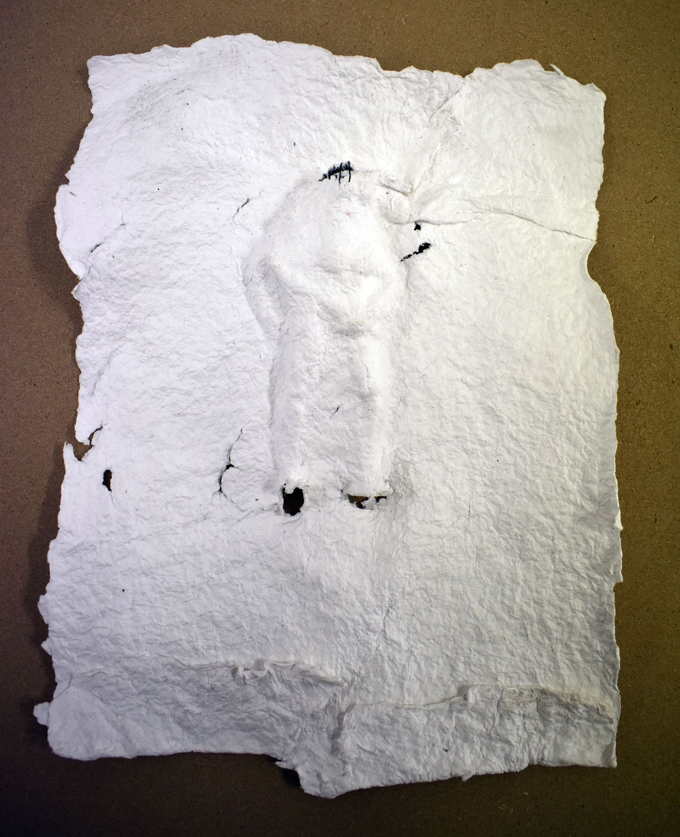
The Project
Paper sculptures
Two or more
Roughly 180cm x 254cm
Made from second hand bed sheets
Human figure cast in negative
Gaps sewn with twine
Scale model test of figure under wet paper sheet

Slide 6
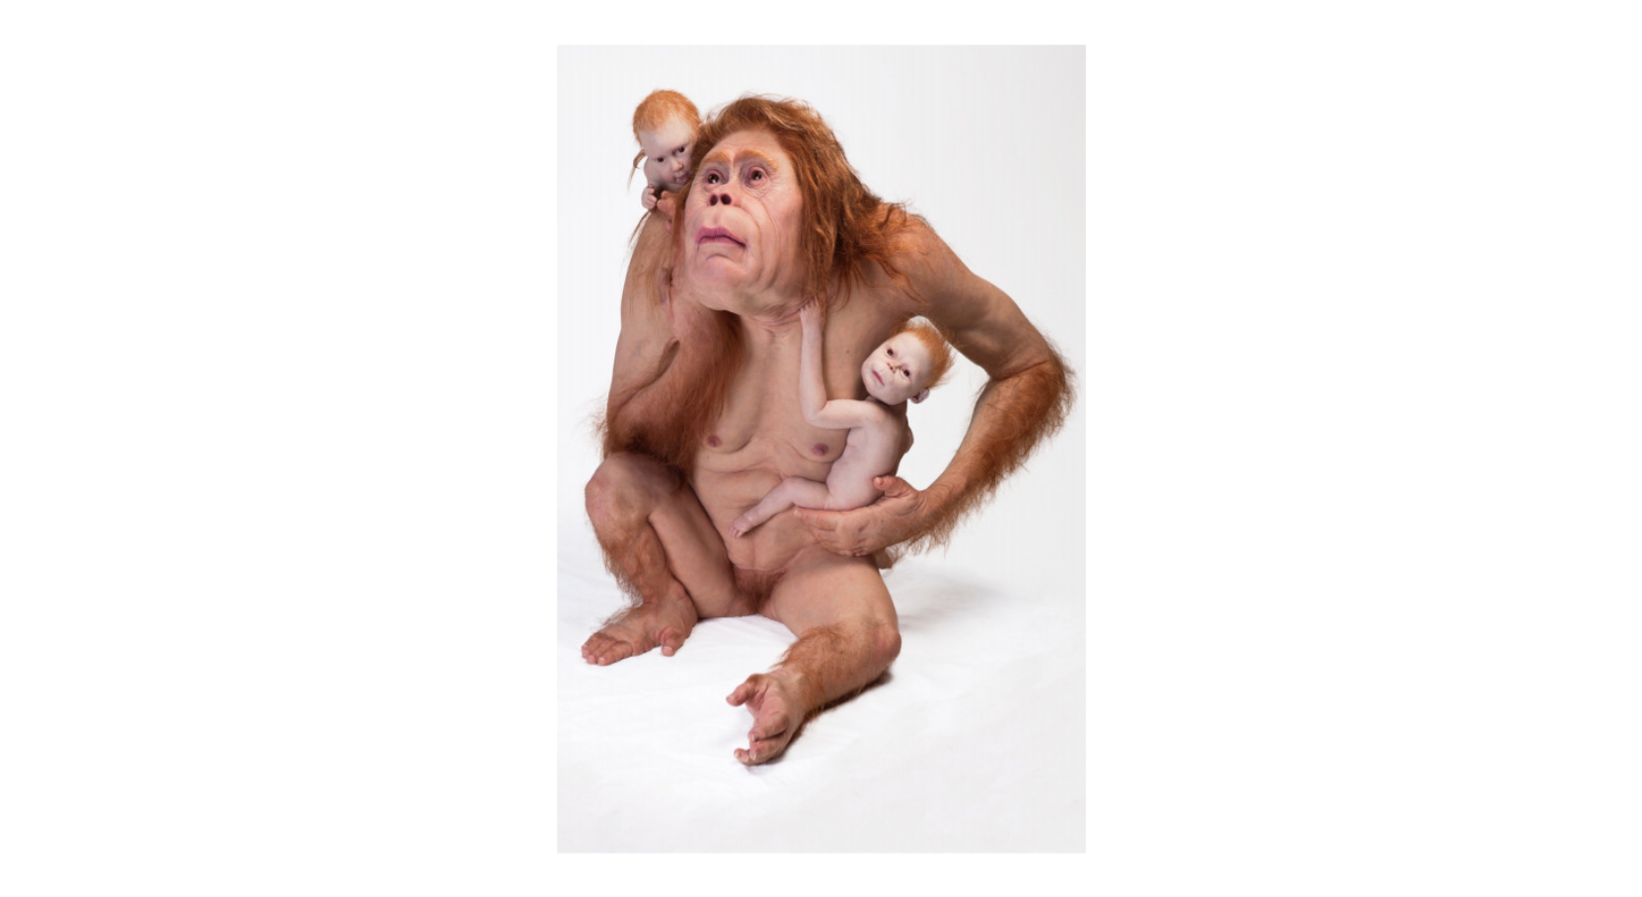
Context
Memory
Connection
Absence
The Body
Feminist Art Theory
Posthumanism
Patricia Piccinini
Kindred
2018

Slide 7
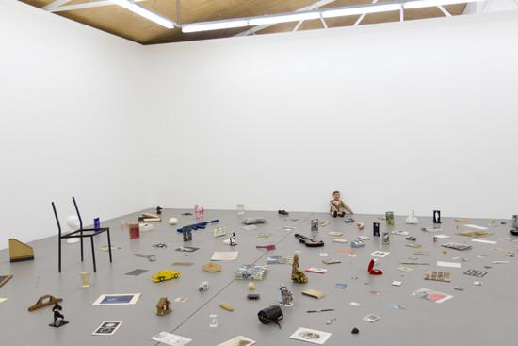
Disconnection
Technology induced loneliness
Longing for physical connection
Unmet desire
Inframince
Patrick Pound
The museum of there, not there
2020

Slide 8
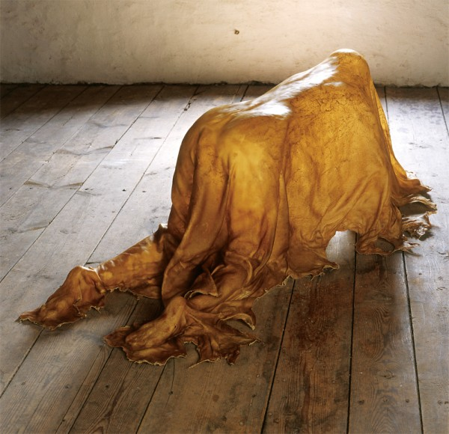
The Body
Object of desire
Absent connection
The female form in feminist art theory
“... a charged gap between the object and its cast, ‘a space of release’ and a space that is ‘heavily impregnated with memory’” - Joan Gibbon (1)
Janine Antoni
Saddle
2000
1. Joan Gibbon, “Traces: Memory and Indexicality” in Contemporary Art and Memory: Images of Recollection and Remembrance, 30. London : I.B. Tauris, 2007.

Slide 9
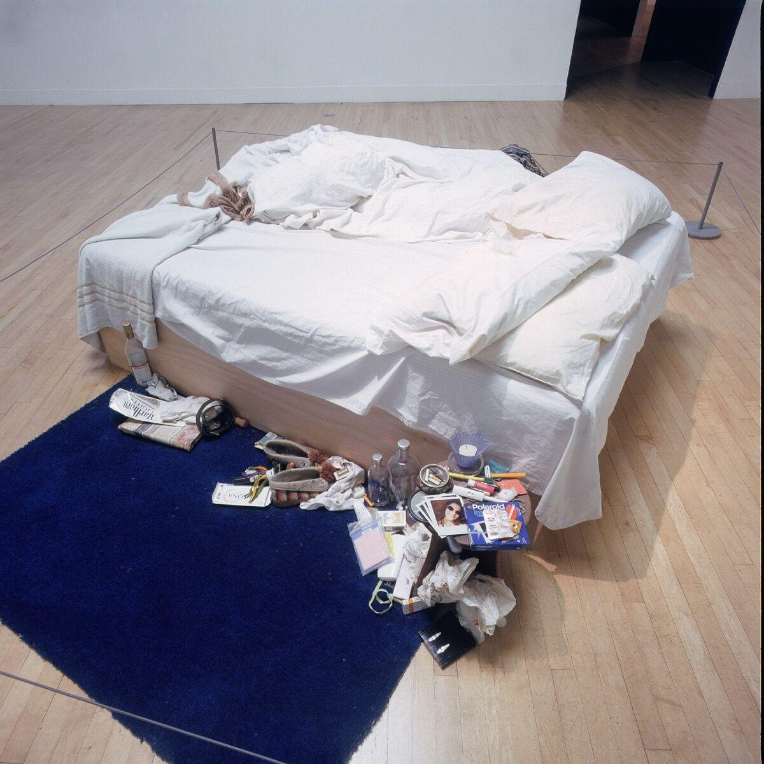
Bedsheets
One of life’s most intimate items
Used all of life
Retains traces of lives lived in them
Unknown origin
Tracey Emin
My Bed
1998

Slide 10
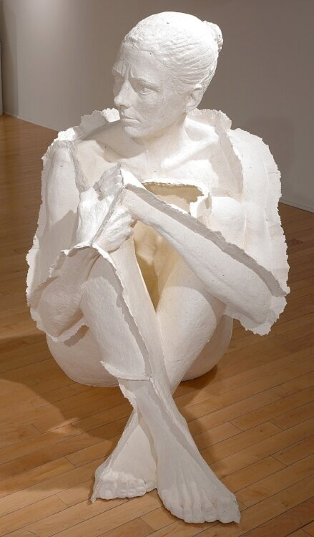
Paper
Technology induced rise of artisanal papermaking
Destructive and creative process (1)
Reconfiguration of material
Lightweight and rigid
“The sheet of paper, with its mark of the maker, took on a presence, evoked a human connection, a life that went beyond its basic utilitarian, well-made integrity.” - Timothy Barrett (2)
1. Amara G. Hark-Weber, “Four Questions- Peace paper Project” in Teaching Artist Journal, vol 11 2013 Issue 2. Page 114-123.
2. Timothy Barrett, “Chapter 1: Traditional European Papermaking” in European Hand Papermaking, 42. Michigan: The Legacy Press, 2018
Deborah Baldizar
Edge
2006

Slide 11
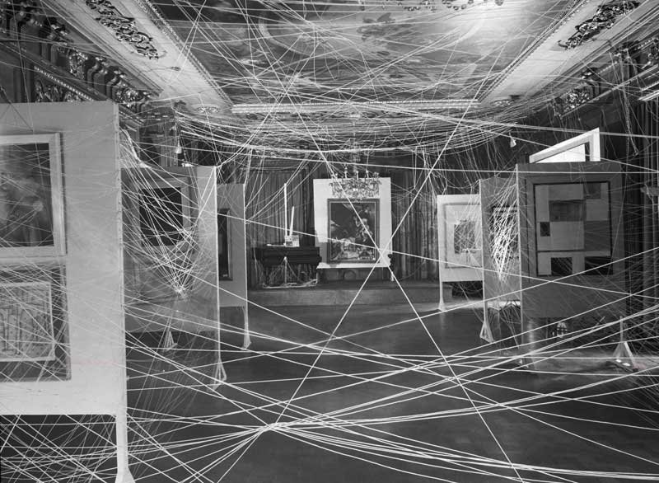
Twine
Happy accident
Failed attempt to draw connection
Revealing internal absence
Denying access
John Schiff
Installation View of Exhibition ‘ First Papers of Surrealism’ Showing String Installation
1942

Slide 12
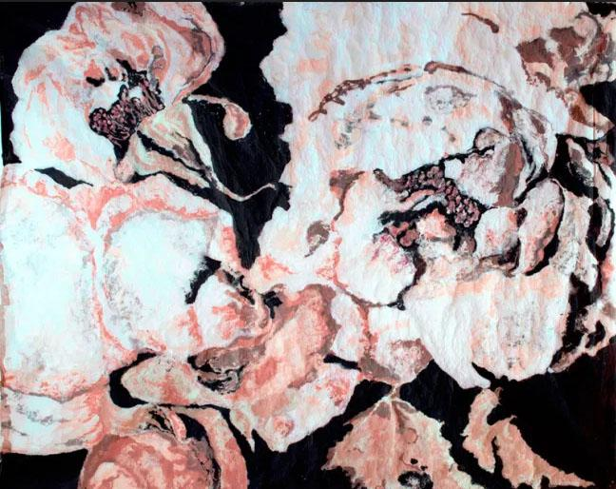
Examplear-
Karen Stone
I’m beginning to fade you know”, the white rose confided, “and then one simply can’t help one’s petals getting a little untidy.
2011
Cotton and linen fibre
1.9 x 2.4 metres

Slide 13
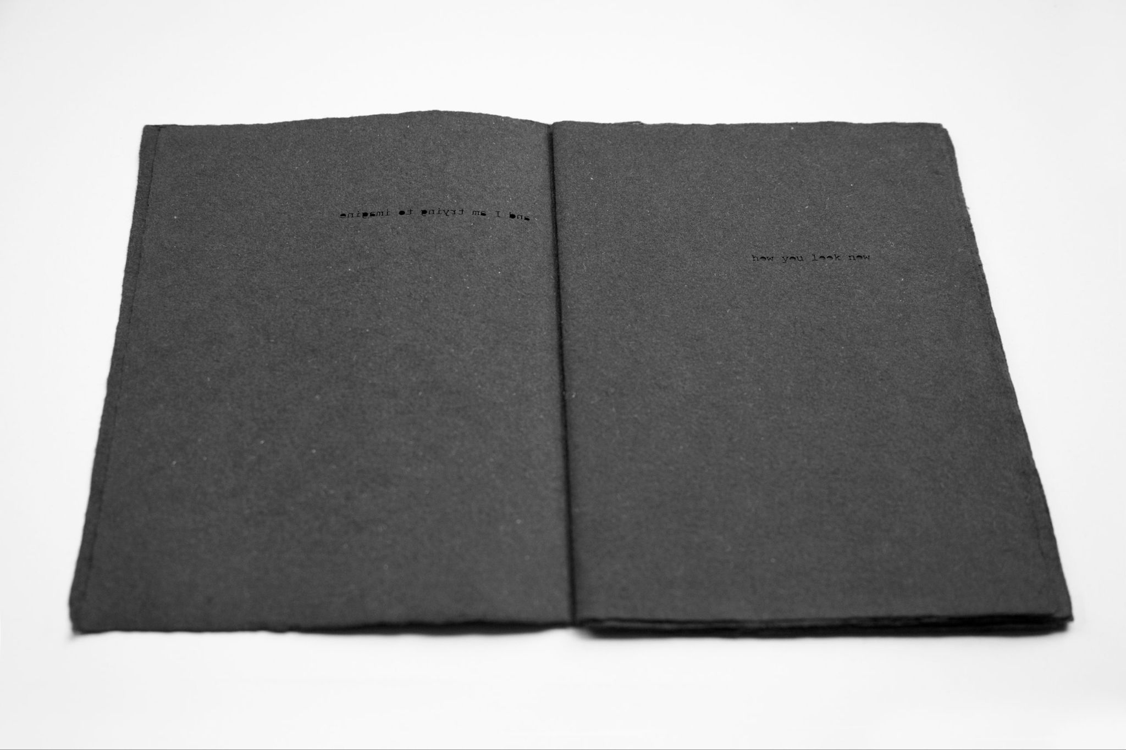
Exemplar- Ana Paula Estrada
I Cannot See You
2018,
Book, Handmade Paper
21 cm x 15cm

Slide 14
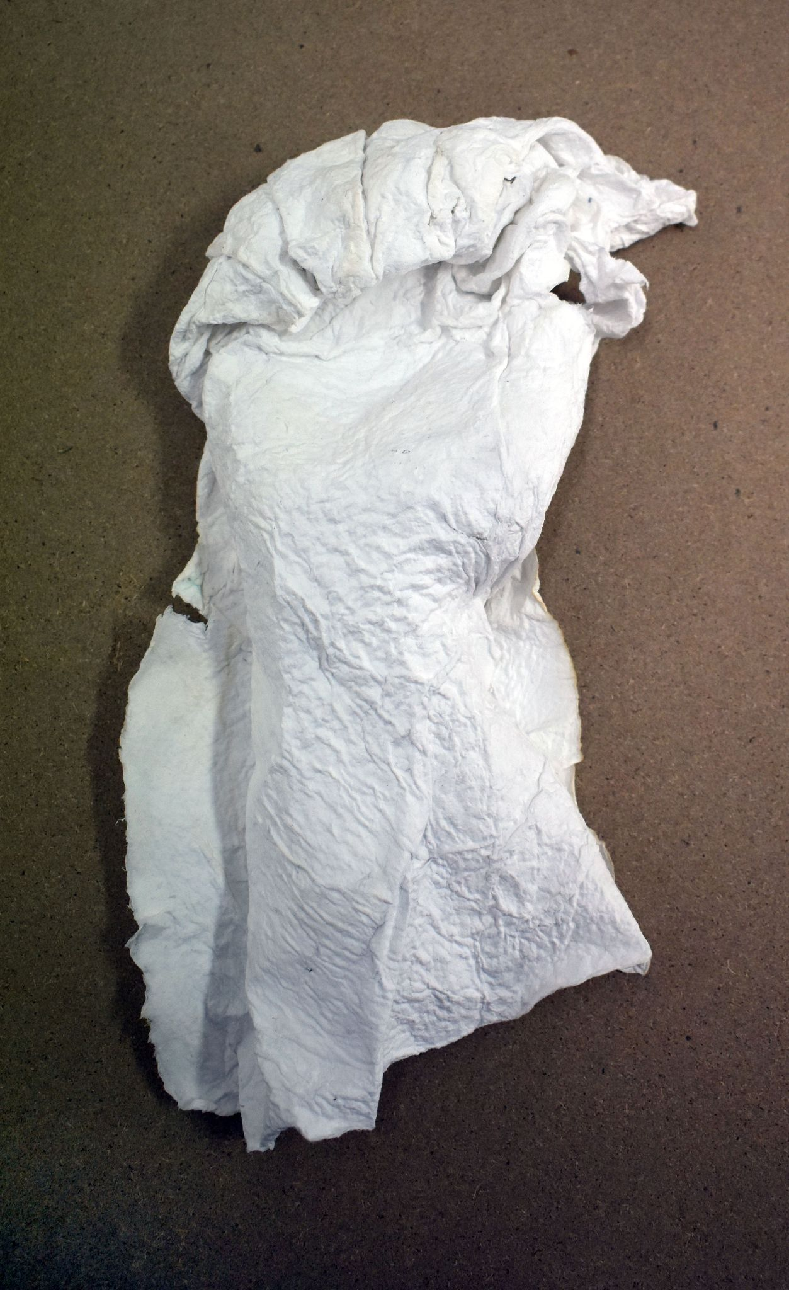
Experimentation
Wet paper cast over human limb
Shaping and stability
Drying time test- hair dryer
Artist’s hand test cast with handmade paper

Slide 15
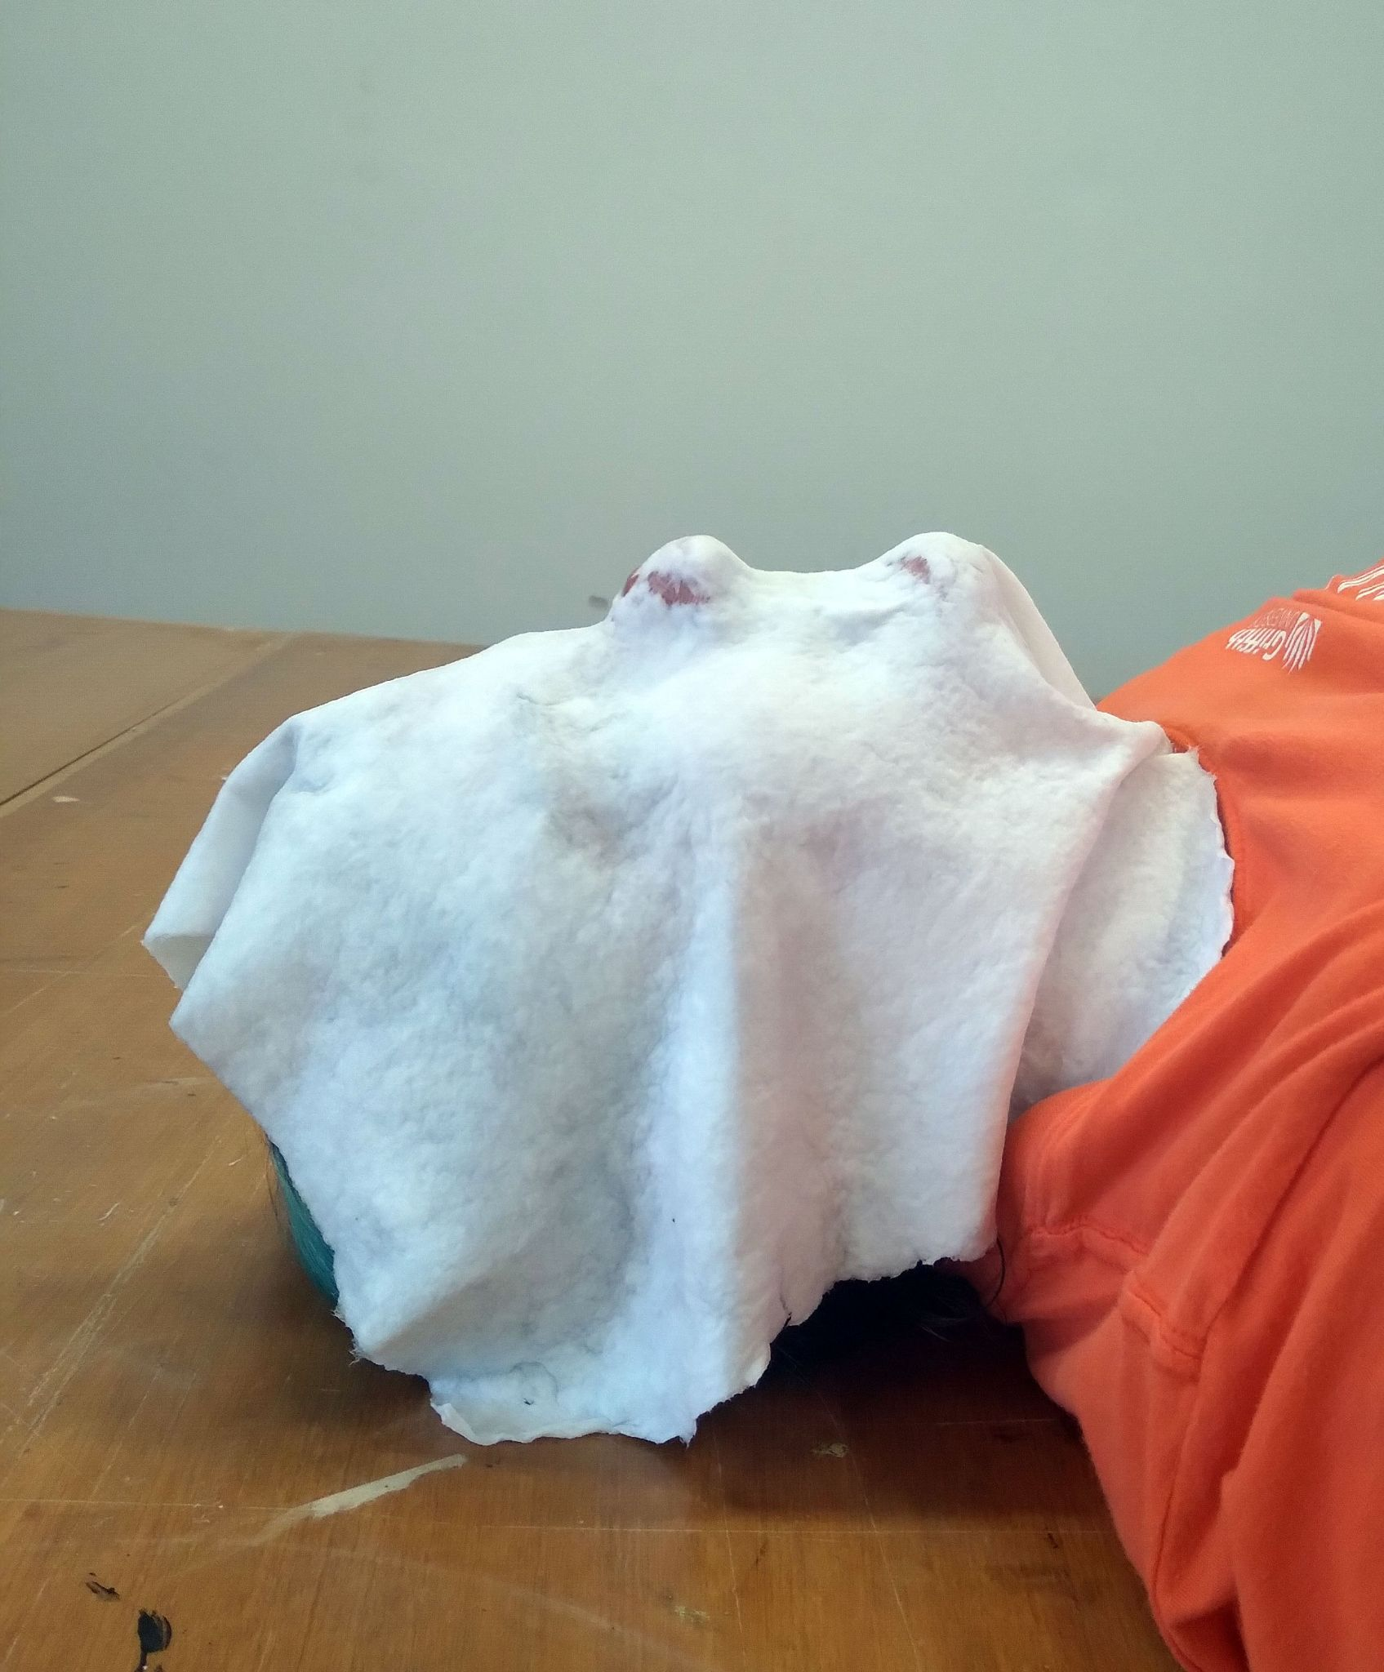
Experimentation
Respiration test- breathing difficult
Air holes required during casting
Wet paper fragile- increase pressing for stability
Artist’s face draped with wet paper sheet

Slide 16
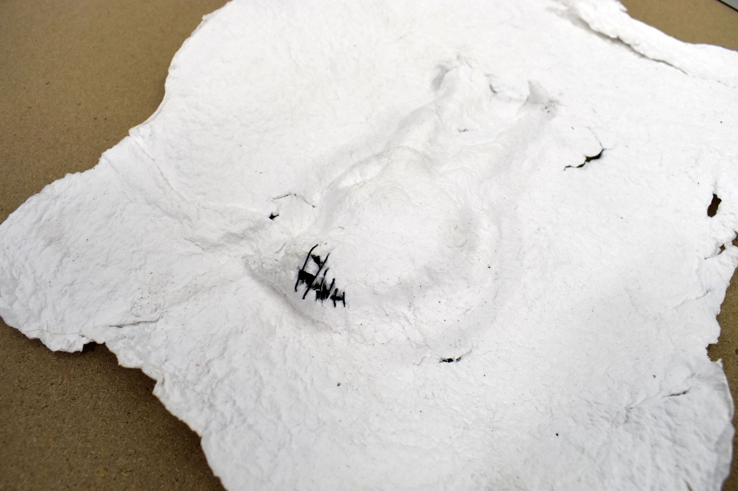
Experimentation
Scale model
Figure less distinctive than expected- good
Tears in paper
Sewing experimentation
Scale model of full figure cast in paper with sewn tear

Slide 17
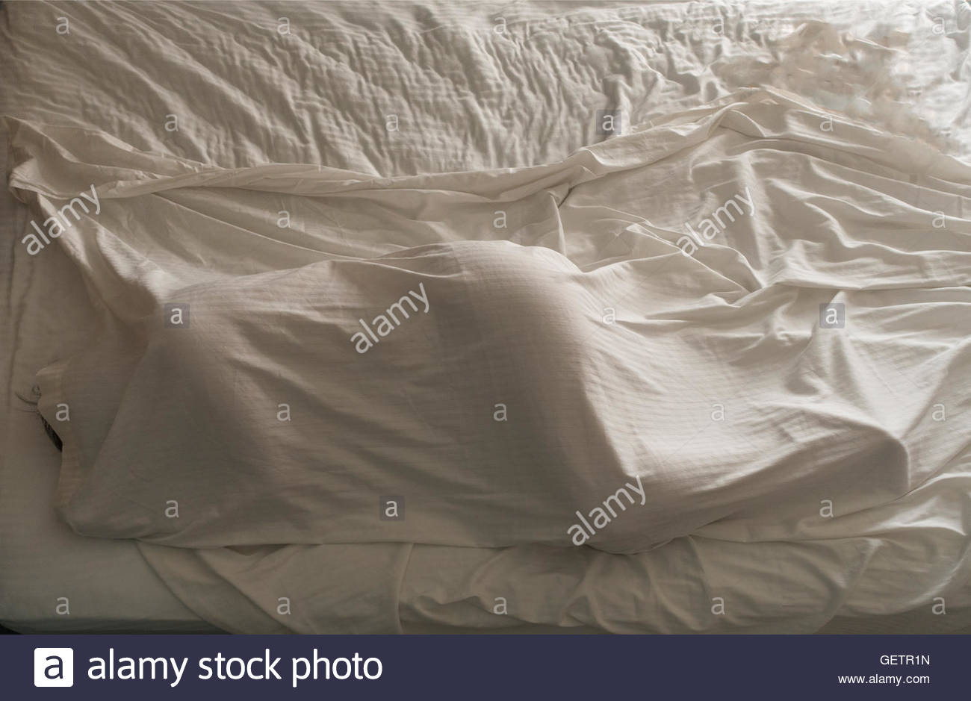
Reflection
Found a wealth of theorists and artists working with these themes
Looking forward to expanding my material experimentation
Continuing my research into the discourse around: memory, the body, disconnection and the infra mince
Woman sleeping under bed sheets
Randy Duchaine
2016

Slide 18
Timeline
Pre- Trimester Source bedsheets Buy additional buckets Research and design mould and deckle Pulp prepared fabric Start running bedsheets | Week 2 July 26-30 Test on mid-sized screen Twine test Build mould and deckle Source additional bedsheets (if required) Continue cutting fabric Pulp prepared fabric Reflection
Week 1 July 19-23 Purchase mould and deckle materials Acquire screen for mid-sized scale tests Contact and organise model and assistance Continue cutting fabric Reflection | Week 3 August 2-6 Full sized paper test Live model test (with assistants) Source bedsheets (if required) Cut fabric Pulp fabric Reflection

Slide 19
Mid-Trimester Break Augusts 9-13 Twine test Source bedsheets (if required) Cut fabric Pulp fabric | Week 5 August 23-27 Source bedsheets (if required) Cut fabric Pulp fabric Form full sized paper sheets Live model soldering session (with assistants) Assess session outcome Sew twine Reflect
Week 4 August 16-20 Form full sized paper sheets Live model molding session (with assistants) Assess session outcome Sew twine Refection | Week 6 August 30- September 3 Source bedsheets (if required) Cut fabric Pulp fabric Form full sized paper sheets Live model soldering session (with assistants) Assess session outcome Sew twine Begin install plan

Slide 20
Week 7 September 6-10 Fine tune sculptures Prepare works for install Acquire light sources Test install Photograph sculptures | Week 8 Onwards Time for all the stuff I mess up

Slide 21
Bibliography

Slide 22
Bibliography Continued
Antoni, Janine. Janine Antoni: Immaculate Conception Inc. Accessed June 6, 2021. http://www.janineantoni.net/.
Art History 101. “Kiki Smith Untitled.” Youtube. Published April 13, 2021. Video, 5:14. https://www.youtube.com/watch?v=qtJ5vF90inw.
Artsy. “Patricia Piccinini: Kindred.” Artsy. Accessed June 6, 2021. https://www.artsy.net/artwork/patricia-piccinini-kindred-1.
Baldizar, Deborah. DeborahBaldizar.com. Accessed June 6, 2021. http://www.deborahbaldizar.com/.
Barrett, Timothy. European Hand Papermaking. Michigan : The Legacy Press. 2018.
Butler, Judith. Gender Trouble : Tenth Anniversary Edition. London: Routledge, 2002.
Cochran, Jessica and Melissa Potter. “Papermaking and Social Action.” Art in Print 3. no. 6 (March-April 2014) 25.
http://libraryproxy.griffith.edu.au/login?url=https://www.jstor.org/stable/43045619.
Cogdill, Michael. “Mediums and Substrates.” Cogdill Concepts. December 8, 2018.
https://mcogdill.home.blog/2018/12/08/mediums-and-substrates/.

Slide 23
Bibliography Continued
Cohen, Alina. “Tracey Emin’s ‘My Bed’ Ignored Society’s Expectations of Women.” Artsy. July 30, 2018.
https://www.artsy.net/article/artsy-editorial-tracey-emins-my-bed-ignored-societys-expectations-women.
Colab Tv. “Kiki Smith Making Paper Bodies Sculpture.” Youtube. Published May 15, 2015. Video, 5:02.
https://www.youtube.com/watch?v=YgQDTvLadmA
Duchaine, Randy. “woman sleeping under bed sheets.” Alamy. June 15, 2016.
https://www.alamy.com/stock-photo-woman-sleeping-under-bed-sheets-112412321.html.
Estrada, Ana Paula. Anapaulestrada.com. Accessed June 6, 2021. https://anapaulaestrada.com
Estrada, Ana Paula. Email correspondence with the author. May 15, 2021.
Gehman, Geoff. “Michener show gets creative with paper.” The Morning Call. April 12, 2009.
https://www.mcall.com/news/mc-xpm-2009-04-12-4350401-story.html.
Gibbons, Joan. “Traces: Memory and Indexicality.” Contemporary Art and Memory: Images of Recollection and Remembrance.
London : I.B. Tauris, 2007.
Goldsmith, Kenneth. 1000 Infrathins. Philadelphia : The Centre for Programs in Contemporary Writing, 2018.

Slide 24
Bibliography Continued
Grosz, Elizabeth. Volatile Bodies. Sydney: Taylor & Francis Group, 1994.
Hark-Weber, Amara G.“Four Questions- Peace paper Project.” Teaching Artist Journal. 11, issue 2 (March 2013): 114-123.
https://doi-org.libraryproxy.griffith.edu.au/10.1080/15411796.2013.761065.
Hopkins, David. “Duchamp, Childhood, Work and Play: The Vernissage for First Papers of Surrealism, New York, 1942” Tate Papers.
no. 22 (Autumn 2014). https://www.tate.org.uk/research/publications/tate-papers/22/duchamp-childhood-wor
k-and-play-the-vernissage-for-first-papers-of-surrealism-new-york-1942.
Modern Edition. “By a thread: String as contemporary art medium” Modern Edition.com. Accessed June 6, 2021.
http://www.modernedition.com/art-articles/string/string-art-history.html.
Museum of Modern Art. “Investigating Identity: The Body in Art.” MoMA Learning. Accessed June 6, 2021.
https://www.moma.org/learn/moma_learning/themes/investigating-identity/the-body-in-art/# .
New Jersey Stage. “Morris Museum Presents: Pulp Culture: Paper is the Medium.” August 29, 2014.
https://www.newjerseystage.com/articles/2014/08/29/morris-museum-presents-pulp-culture-paper-is-the-medium/.

Slide 25
Bibliography Continued
Parents Circle Families Forum. “Fabric of War.” 2010.
https://www.theparentscircle.org/en/pcff-activities_eng/pcff-exhibitions_eng/fabric-of-war_eng/.
Photo. “Q&A with Patrick Pound” photo.org.au. May 19, 2020. https://photo.org.au/channel/qa-with-patrick-pound.
Several Circles | Art History. “Know the Artist: Kiki Smith” Youtube. Published March 21, 2019. Video, 5:15.
https://www.youtube.com/watch?v=URfMjVi76aE
Silver, Zoe. “Cloth & Memory.” Transition and Influence. Accessed June 6, 2021.
https://transitionandinfluence.com/cloth-and-memory.
Snizek, Rick. “‘Pulp Function’ display at Narrows Center finds fiber transformed into art” South Coast Today, February 21, 2008.
https://www.southcoasttoday.com/article/20080221/PUB03/802210401.
Station. “Patrick Pound” Station Gallery. Accessed June 6, 2021.https://stationgallery.com.au/artists/patrick-pound.
Stills. “Patrick Pound.” Stills Gallery. Accessed June 6, 2021. http://www.stillsgallery.com.au/artists/pound/.

Slide 26
Bibliography Continued
Stone, Karen. “Karen Stone: Visual Artist.” Karenstoneartist.com. Accessed June 6, 2021. https://www.karenstoneartist.com/.
Stone, Karen. In person interview with the author. May 11, 2021.
Townsen, Jen and Renée Zettle-Sterling. “Fine Art: Idea vs. Object.” Cast: art and objects made using humanity's most
transformational process. Pennsylvania : Schiffer Publishing Ltd. 2017.
Thank you for watching
MSP A2 Viva
Alanna Bingham
s5061237

